Slide 1
UNIT TESTING TOOLS
JUnit and Mockito
Team Crystals
24/04/2023

Slide 2
JUnit

Slide 3
JUnit
Java provides a framework called JUnit to perform the unit testing of our Java code. In the development of test-driven development, JUnit is especially important. The JUnit is one of the frameworks available in the unit testing frameworks.
JUnit promotes the idea of "first testing then coding", which emphasizes setting test data for a piece of code that can be tested first and then implemented.
To perform unit testing, we need to create test cases. The unit test case is a code which ensures that the program logic works as expected.
The Junit 4.x framework is annotation based

Slide 4

Features of JUnit:
An open-source framework used to write and run tests.
For testing the expected result, the JUnit provides assertions.
To identify the test methods, it provides annotation.
We can write the code faster for increasing quality using JUnit.
For running tests, it provides test runners.
It is quite simple, not so complex and requires less time.

Slide 5
Annotations used while writing the test cases:
@Test annotation specifies that method is the test method.
@Test(timeout=1000) annotation specifies that method will be failed if it takes longer than 1000 milliseconds .
@BeforeClass annotation specifies that method will be invoked only once, before starting all the tests.
@Before annotation specifies that method will be invoked before each test.
@After annotation specifies that method will be invoked after each test.
@AfterClass annotation specifies that method will be invoked only once, after finishing all the tests.

Slide 6
The common methods of Assert class are as follows:
void assertEquals(boolean expected,boolean actual): checks that two primitives/objects are equal. It is overloaded.
1
void assertTrue(boolean condition): checks that a condition is true.
2
void assertFalse(boolean condition): checks that a condition is false.
3
void assertNull(Object obj): checks that object is null.
4
void assertNotNull(Object obj): checks that object is not null.
5

Slide 7
Application:
JUnit is primarily used for writing and running unit tests for Java code.
It helps developers to test individual units of code in isolation, which enables them to detect and fix bugs quickly.
JUnit helps developers to write tests and run them quickly, making it easier to follow the TDD process.
Unit can also be used to analyze code coverage, which is the percentage of code that is covered by tests.

Slide 8
Test program
package com.javatpoint.testcase;
import static org.junit.Assert.*;
import com.javatpoint.logic.*;
import org.junit.Test;
public class TestLogic {
@Test
public void testFindMax(){
assertEquals(4,Calculation.findMax(new int[]{1,3,4,2}));
assertEquals(-1,Calculation.findMax(new int[]{-12,-1,-3,-4,-2}));
}
}

Slide 9
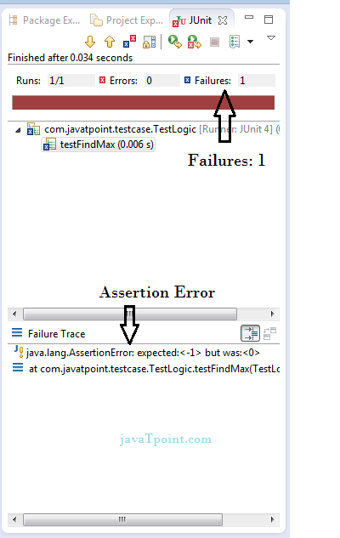

Slide 10
Program Logic
package com.javatpoint.logic;
public class Calculation {
public static int findMax(int arr[]){
int max=arr[0];//arr[0] instead of 0
for(int i=1;i<arr.length;i++){
if(max<arr[i])
max=arr[i];
}
return max;
}
}

Slide 11
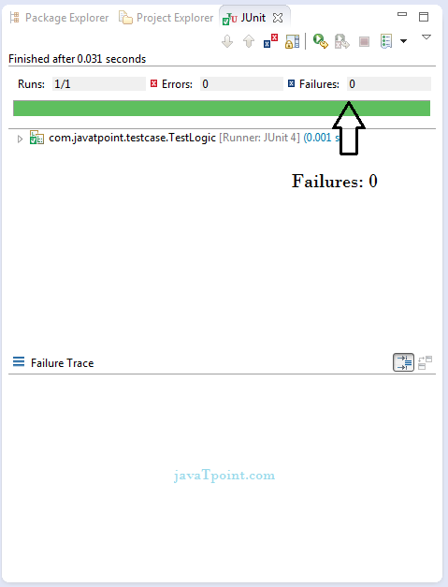

Slide 12

MOCKITO

Slide 13
Mockito
Mockito is a Java-based mocking framework used for unit testing of Java application.
Mockito plays a crucial role in developing testable applications.
Mockito was released as an open-source testing framework under the MIT (Massachusetts Institute of Technology) License.
It internally uses the Java Reflection API to generate mock objects for a specific interface.
Mock objects are referred to as the dummy or proxy objects used for actual implementations.
The main purpose of using the Mockito framework is to simplify the development of a test by mocking external dependencies and use them in the test code.
As a result, it provides a simpler test code that is easier to read, understand, and modify.

Slide 14
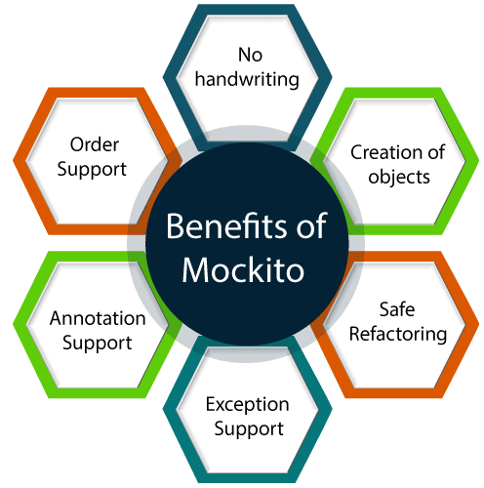
Benefits of Mockito
No handwriting: In Mockito, there is no requirement for writing your mock objects.
No handwriting: In Mockito, there is no requirement for writing your mock objects.
Safe refactoring: While renaming the method name of an interface or interchanging the parameters do not change the test code, as mock objects are created at runtime.
Exception support: It supports the exception. In Mockito, the stack trace is used to find the cause of the exception.
Annotation support: It creates mock objects using annotations like @Mock.
Order support: It provides a check on the order of the method calls.

Slide 15
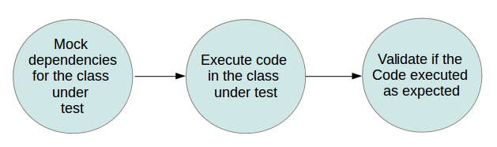
Using Mockito for mocking objects in unit tests

Slide 16
testSort()
{
testList = [1, 7, 3, 8, 2]
MySorter.sort(testList)
assert testList equals [1, 2, 3, 7, 8]
}
// incorrect would be behavior testing // the following tests internal of the implementation
testSort()
{
testList = [1, 7, 3, 8, 2]
MySorter.sort(testList)
assert that compare(1, 2) was called once
assert that compare(1, 3) was not called
assert that compare(2, 3) was called once .... }

Slide 17
Mockito mock() method
It is used to create mock objects of a given class or interface. Mockito contains five mock() methods with different arguments. When we didn't assign anything to mocks, they will return default values. All five methods perform the same function of mocking the objects.
Following are the mock() methods with different parameters:
mock() method with Class: It is used to create mock objects of a concrete class or an interface. It takes a class or an interface name as a parameter. Syntax: <T> mock(Class<T> classToMock)

Slide 18
mock() method with Answer: It is used to create mock objects of a class or interface with a specific procedure. It is an advanced mock method, which can be used when working with legacy systems. It takes Answer as a parameter along with the class or interface name. The Answer is an enumeration of pre-configured mock answers. Syntax: <T> mock(Class<T> classToMock, Answer defaultAnswer)
mock() method with MockSettings: It is used to create mock objects with some non-standard settings. It takes MockSettings as an additional setting parameter along with the class or interface name. MockSettings allows the creation of mock objects with additional settings. Syntax: <T> mock(Class<T> classToMock, MockSettings mockSettings)

Slide 19
mock() method with ReturnValues: It allows the creation of mock objects of a given class or interface. Now, it is deprecated, as ReturnValues are replaced with Answer. Syntax: <T> mock(Class<T> classToMock, ReturnValues returnValues)
mock() method with String: It is used to create mock objects by specifying the mock names. In debugging, naming mock objects can be helpful whereas, it is a bad choice using with large and complex code.

Slide 20
Syntax: <T> mock(Class<T> classToMock, String name)
FX
return new MockSettingsImpl().defaultAnswer(RETURNS_DEFAULTS);
}
Fllowing code snippet shows how to use mock() method:
ToDoService doService = mock(ToDoService.class);

Slide 21
Mockito when() method
It enables stubbing methods. It should be used when we want to mock to return specific values when particular methods are called. In simple terms, "When the XYZ() method is called, then return ABC." It is mostly used when there is some condition to execute.
Syntax: <T> when(T methodCall)
Following code snippet shows how to use when() method:
when(mock.someCode ()).thenReturn(5);
In the above code, thenReturn() is mostly used with the when() method.

Slide 22
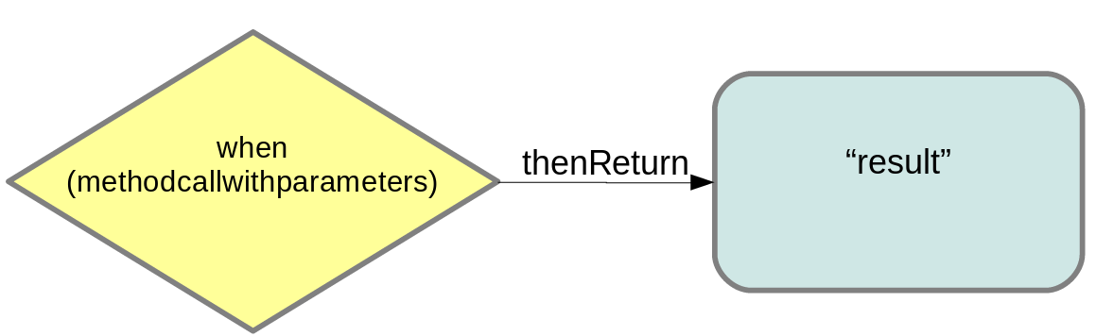

Slide 23
Mockito verify() method
The verify() method is used to check whether some specified methods are called or not. In simple terms, it validates the certain behavior that happened once in a test. It is used at the bottom of the testing code to assure that the defined methods are called.
Mockito framework keeps track of all the method calls with their parameters for mocking objects. After mocking, we can verify that the defined conditions are met or not by using the verify() method. This type of testing is sometimes known as behavioral testing. It checks that a method is called with the right parameters instead of checking the result of a method call.

Slide 24
The verify() method is also used to test the number of invocations. So we can test the exact number of invocations by using the times method, at least once method, and at most method for a mocked method.
There are two types of verify() methods available in the Mockito class, which are given below:
verify() method: It verifies certain behavior happened once. Syntax: <T> verify(T mock)
verify() method with VerificationMode: It verifies some behavior happened at least once, exact number of times, or never. Syntax: <T> verify(T mock, VerificationMode mode)

Slide 25
Mockito spy() method
Mockito provides a method to partially mock an object, which is known as the spy method. When using the spy method, there exists a real object, and spies or stubs are created of that real object. If we don't stub a method using spy, it will call the real method behavior. The main function of the spy() method is that it overrides the specific methods of the real object. One of the functions of the spy() method is it verifies the invocation of a certain method.

Slide 26
There are two types of spy() methods available in the Mockito class:
spy() method: It creates a spy of the real object. The spy method calls the real methods unless they are stubbed. We should use the real spies carefully and occasionally, for example, when dealing with the legacy code. Syntax: <T> spy(T object)
spy() method with Class: It creates a spy object based on class instead of an object. The spy(T object) method is particularly useful for spying abstract classes because they cannot be instantiated. Syntax: <T> spy(Class<T> classToSpy)
Following code snippet shows how to use the spy() method:
List spyArrayList = spy(ArrayList.class);

Slide 27
Mockito reset() method
The Mockito reset() method is used to reset the mocks. It is mainly used for working with the container injected mocks. Usually, the reset() method results in a lengthy code and poor tests. It's better to create new mocks rather than using reset() method. That is why the reset() method is rarely used in testing.
The signature of the reset() method is:
public static <T> void reset(T ... mocks) {
MOCKITO_CORE.reset(mocks);
}

Slide 28
Mockito doAnswer() method
It is used when we want to stub a void method with a generic Answer type. The signature of the doAnswer() method is:
public static Stubber doAnswer(Answer answer) {
return MOCKITO_CORE.doAnswer(answer);
}
Mockito doNothing() method
It is used for setting void methods to do nothing. The doNothing() method is used in rare situations. By default, the void methods on mock instances do nothing, i.e., no task is performed.
The signature of doNothing() method is:
public static Stubber doNothing() {
return MOCKITO_CORE.doAnswer(new DoesNothing());
}

Slide 29
Mockito doReturn() method
It is used on those rare occasions when we cannot use Mockito.when(object). The Mockito.when(object) method is always suggested for stubbing because it is argument type-safe and more readable as compare to the doReturn() method.
The signature of doReturn() method is:
public static Stubber doReturn(Object toBeReturned) {
return MOCKITO_CORE.doAnswer(new Returns(toBeReturned));
}

Slide 30
Mockito inOrder() method
It is used to create objects that allow the verification of mocks in a specific order. Verification done in order is more flexible as we don't have to verify all interactions. We need to verify only those interactions that are interested in testing (in order). We can also use the inOrder() method to create an inOrder object passing mocks that are relevant for in-order verification.
The signature of Mockito.inOrder() method is:
public static InOrder inOrder(Object... mocks) {
return MOCKITO_CORE.inOrder(mocks);
}

Slide 31
Mockito verifyNoMoreInteractions() method
It is used to check that any of the given mocks have any unverified interactions. We can use this method after verifying all the mock, to make sure that nothing else was invoked on the mocks. It also detects the unverified invocations that occur before the test method, for example, in setup(), @Before method, or the constructor. It is an optional method, and we don't need to use it in every test.
The signature of the verifyNoMoreInteractions() method is:
public static void verifyNoMoreInteractions(Object... mocks) {
MOCKITO_CORE.verifyNoMoreInteractions(mocks);
}

Slide 32
Mockito verifyZeroInteractions() method
It verifies that no interaction has occurred on the given mocks. It also detects the invocations that have occurred before the test method, for example, in setup(), @Before method or the constructor.
The signature of the verifyZeroInteractions() method is:
public static void verifyZeroInteractions(Object... mocks) {
MOCKITO_CORE.verifyNoMoreInteractions(mocks);
}

Slide 33
Mockito doThrow() method
It is used when to stub a void method to throw an exception. It creates a new exception instance for each method invocation. There are two types of doThrow() methods available in the Mockito class with different parameters, as shown below:
doThrow() method with Throwable: This method is used when we want to stub a void method with an exception. Syntax: doThrow(Throwable toBeThrown)
The signature of the doThrow() method is:
public static Stubber doThrow(Throwable toBeThrown) {
return MOCKITO_CORE.doAnswer(new ThrowsException(toBeThrown));
}

Slide 34
doThrow() method with Class: This method is used when we want to stub a void method to throw an exception of a specified class. Syntax: doThrow(Class<? extends Throwable> toBeThrown) The signature of doThrow() method is:
public static Stubber doThrow(Class<? extends Throwable> toBeThrown) {
return MOCKITO_CORE.doAnswer(new ThrowsExceptionClass(toBeThrown));
}

Slide 35
Mockito doCallRealMethod() method
It is used when we want to call the real implementation of a method. In other words, it is used to create partial mocks of an object. It is used in rare situations, such as to call the real methods. It is similar to the spy() method, and the only difference is that it results in complex code.
The signature of the doCallRealMethod() method is:
public static Stubber doCallRealMethod() {
return MOCKITO_CORE.doAnswer(new CallsRealMethods());
}

Slide 36
CONCLUSION
JUnit and Mockito are complementary tools that are often used together in Java unit testing.
JUnit is used to write test cases and run tests, while Mockito is used to create mock objects that can be used in the tests.
Writing effective unit tests with JUnit and Mockito can greatly improve the quality and reliability of Java code.
Unit tests help to catch bugs early in the development process, which can save time and money by avoiding issues in production.
Mockito allows developers to test code in isolation, which helps to ensure that the tests are focused and accurate.

